Slide 1
Radius of Curvature Depends on the Thickness of Silicon Wafers
Hande GÜNDÜZÖZ
25.03.2016

Slide 2
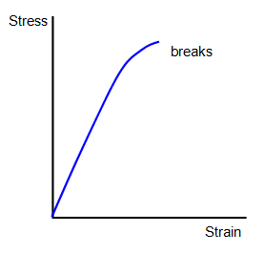
Fracture Strength of Silicon
Silicon is brittle material
Ultimate Stress = Yield Stress
Can be measured with tensile test.
Engineering stress vs strain curve
A thinner wafer is more flexible and capable of absorbing higher stress before failing.
However when it reaches a critical thickness(<200 micron) there is not sufficient material to sustain its flexibility.
Figure 1. Engineering stress vs strain curve

Slide 3
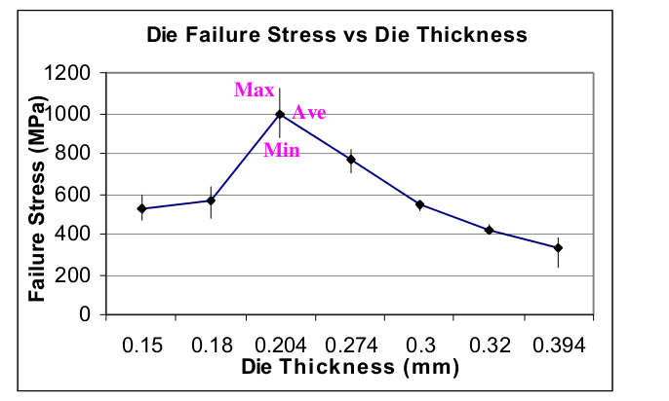
Failure Stress for Different Thicknesses*
*D. Chong,Mechanical characterization in failure strength of silicon dice,2004
Figure 2. Failure Stress vs Thickness Graph
Fracture strength
~ 900 MPa for 200 micron
~ 500 MPa for the others

Slide 4
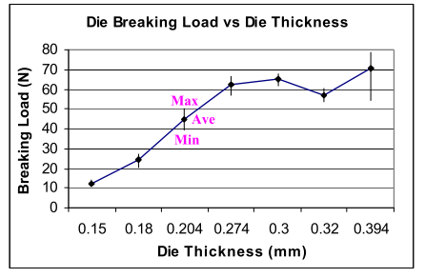
Breaking Load for Different Thicknesses*
*D. Chong,Mechanical characterization in failure strength of silicon dice,2004
Figure 3.Breaking Load vs Thickness Graph
Breaking Load
~ 50 N for 200 micron
~ 11 N for the others

Slide 5

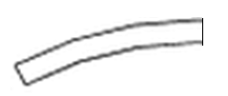
Free Body Diagram
Critical Section
d
c
c
r_{o}
r_{i}
F
Figure 4. Free body diagram of the wafer
Figure 5. Cross section of the wafer
M
F
F
Figure 6. Critical Section of the wafer

Slide 6
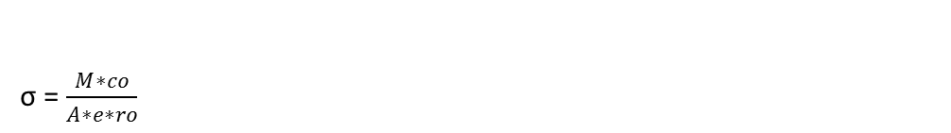
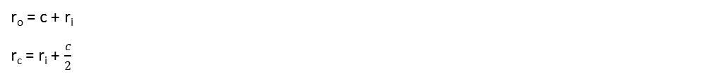

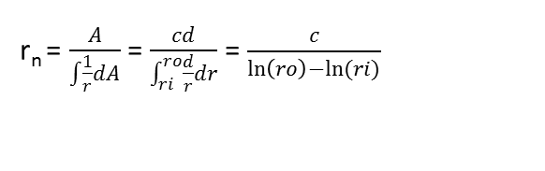
Bending Moment Formulation
σ =
r_{o} = c + r_{i}
r_{c} = r_{i} +
c_{o} = r_{o} – r_{i}
c_{i} = r_{n} - r_{i}
e = r_{c} – r_{n}
A = d*c
r_{n} = = =

Slide 7
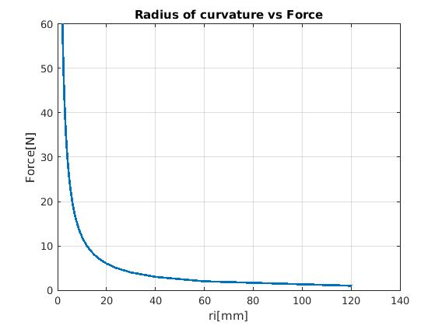
200 Micron
Force between 0 N to 60N ( according to reference paper)

Slide 8
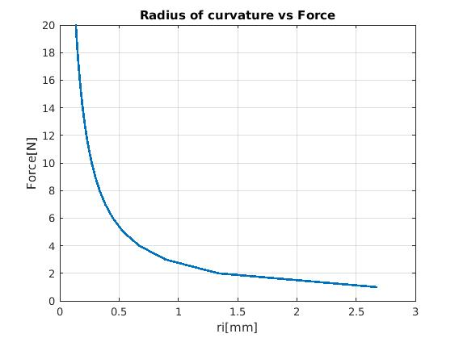
40 Micron
Force between 0 N to 20 N

Slide 9
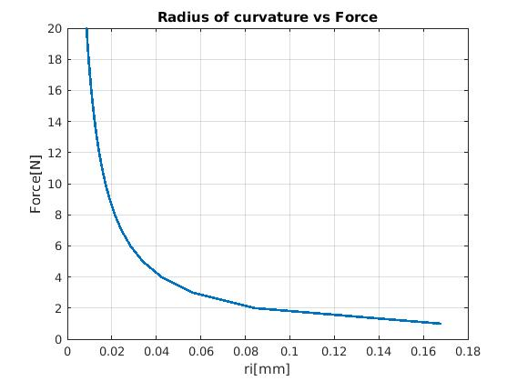
10 Micron
Force between 0 N to 20 N

Slide 11
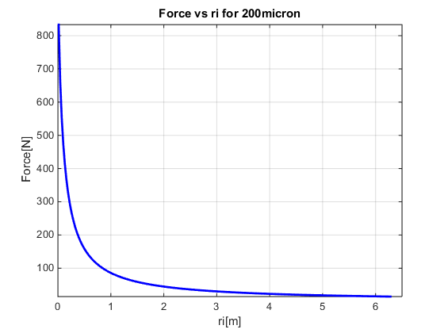
200 micron

Slide 12
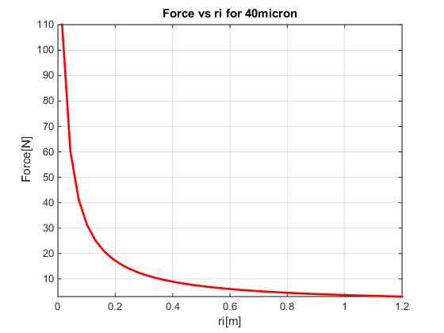
40 micron

Slide 13
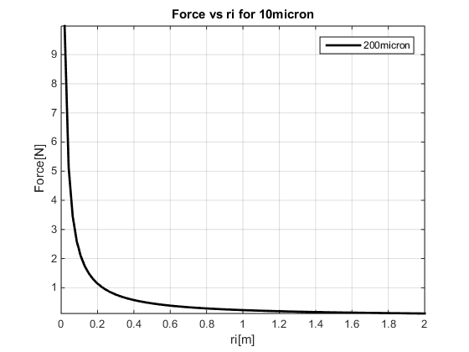
10 micron

